Slide 1

18CSE392T – Machine Learning I
Department of Data Science and Business Systems

Slide 2
OVERFITTING and UNDERFITTING

Slide 3
Terms
In predictive modelling, Signal refers to the true underlying pattern that helps the model to learn the data
Signal

Slide 4
Terms
Noise is irrelevant and random data in the dataset.
Noise

Slide 5
Overfitting
Overfitting refers to a model that models the training data too well.
Overfitting happens when a model learns the detail and noise in the training data to the extent that it negatively impacts the performance of the model on new data.
This means that the noise or random fluctuations in the training data is picked up and learned as concepts by the m odel.
The problem is that these concepts do not apply to new data and negatively impact the models ability to generalize.

Slide 6
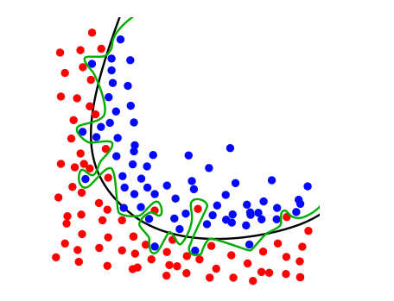
Black line – Good fit Green line - Over fit

Slide 7
The main challenge of overfitting is to estimate the accuracy of the performance of our model with new data

Slide 8
Techniques to reduce overfitting
Reduce model complexity.
Early stopping during the training phase.
Use dropout for neural networks to tackle overfitting

Slide 9
Underfitting
Underfitting refers to a model that can neither model the training data nor generalize to new data.
An underfit machine learning model is not a suitable model and will be obvious as it will have poor performance on the training data.

Slide 10
Techniques to reduce underfitting
Increase model complexity
Increase number of features
Remove noise from the data.
Increase the number of epochs or increase the duration of training to get better results.

Slide 11
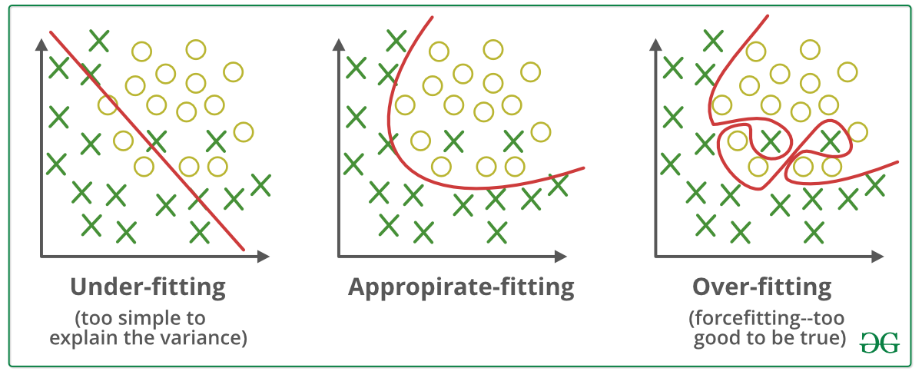

Slide 12


